Slide 1
Telecom Analysis [Code Basics Resume Project Challenge]
File created on: 1/15/2023 4:39:01 AM

Slide 2
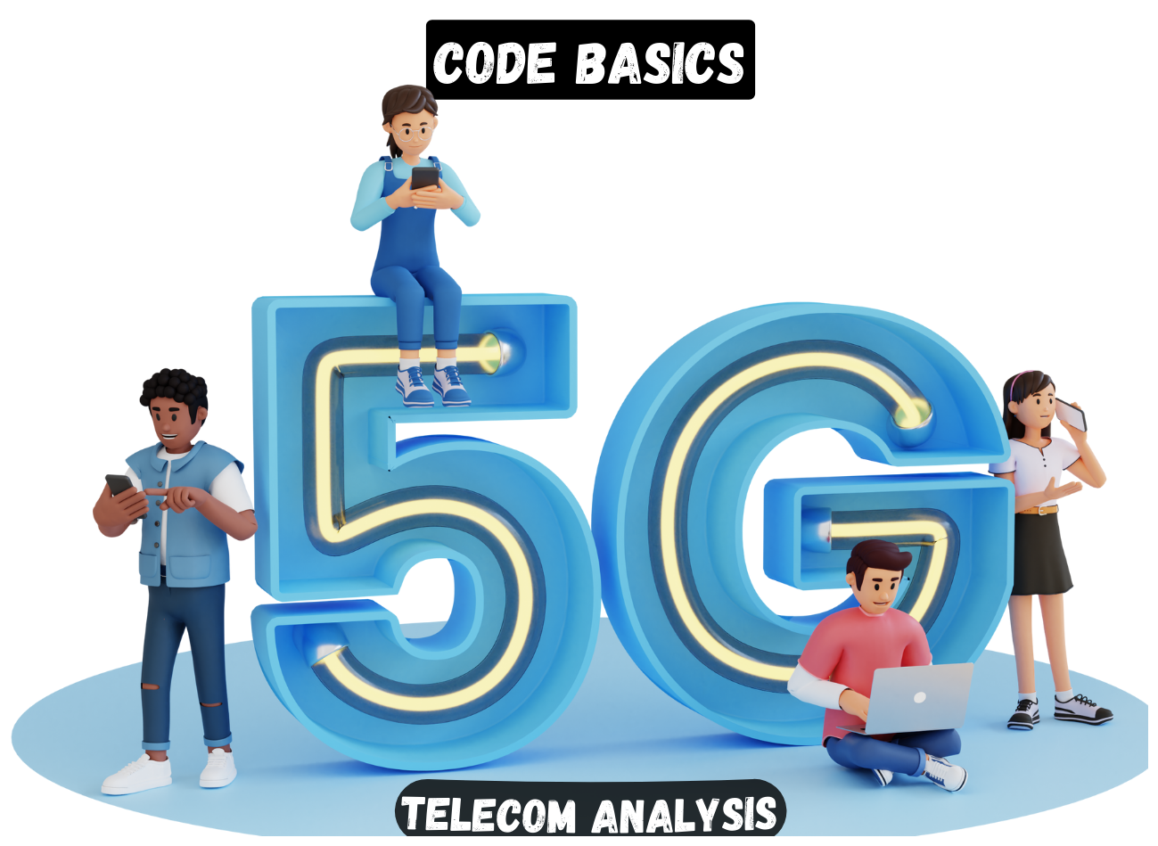

Slide 3
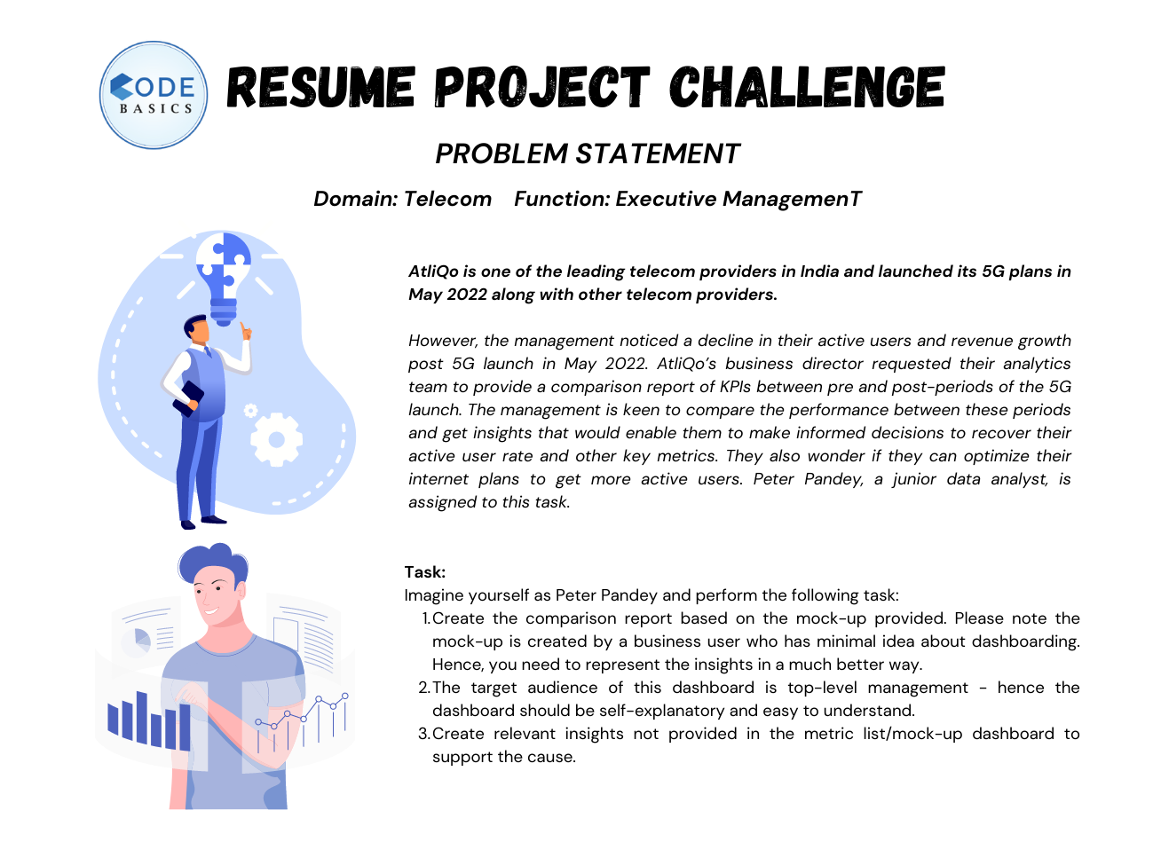

Slide 4
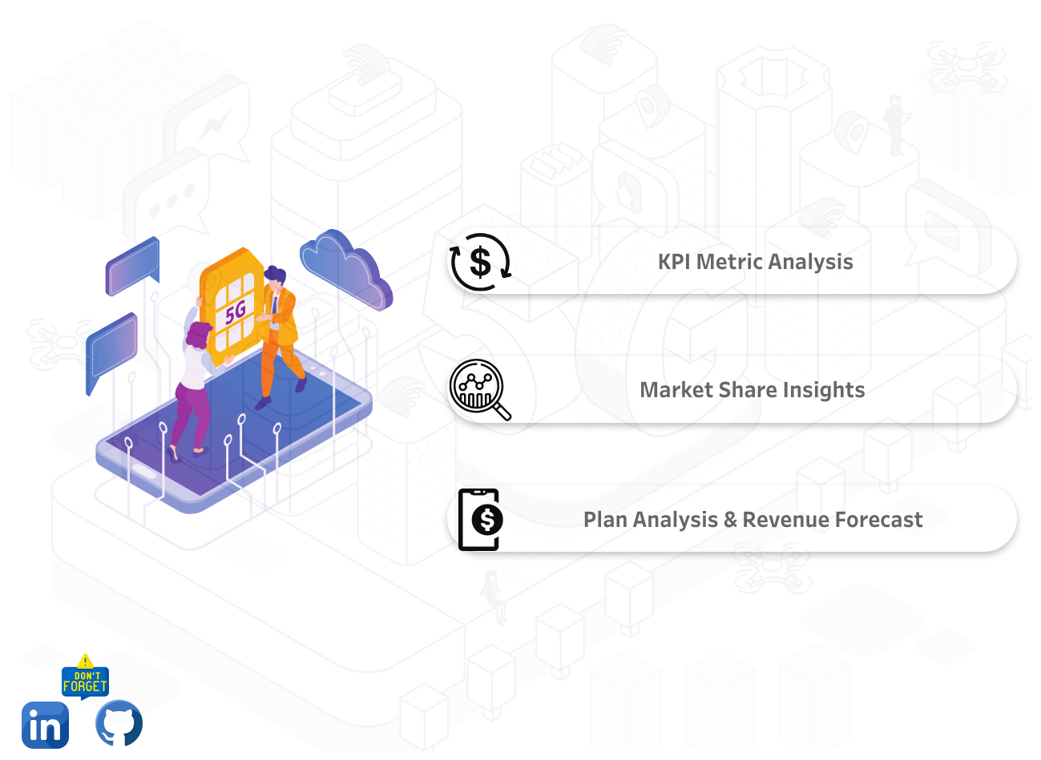

Slide 5
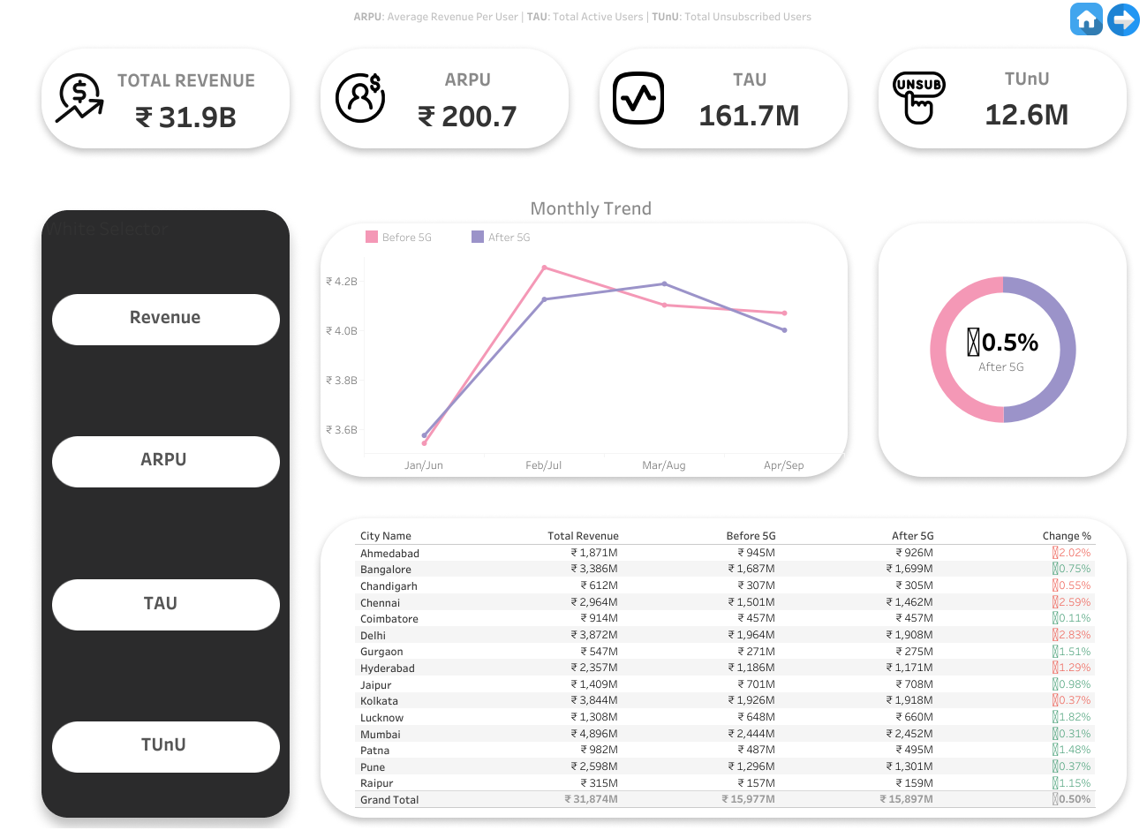

Slide 6
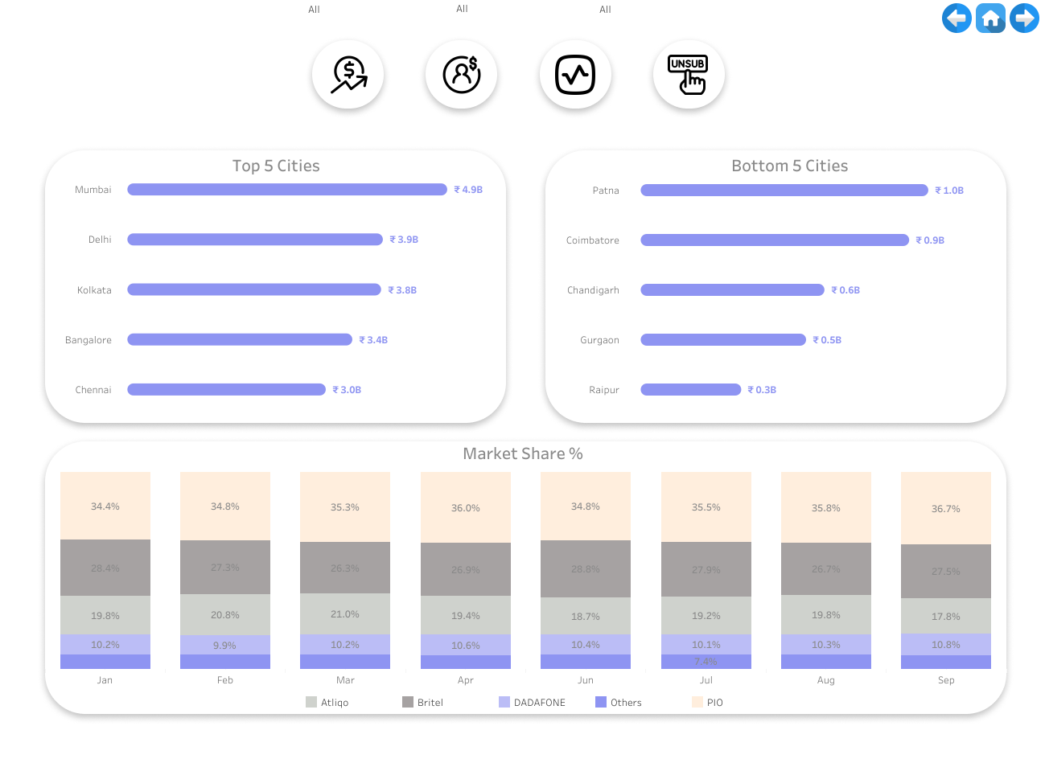

Slide 7
